Slide 1
Learning to Hallucinate Face Images via Component
Generation and Enhancement
Yibing Song¹, Jiawei Zhang¹, Shengfeng He², Linchao Bao³, and Qingxiong Yang⁴
City University of Hong Kong¹
South China University of Technology²
Tencent AI Lab³
University of Science and Technology of China⁴
Notes:
We present our work titled as Learning to hallucinate face images via component generation and enhancement. The authors are from city university of hong kong, south china university of technology, tencent ai lab, and university of science and technology of china.

Slide 2
1. Introduction
2. Related work
3. Proposed algorithm
4. Demo and results
Notes:
We present our work in the following aspects. First, we give a brief introduction of the face hallucination topic and its applications, then we survey the existing work and analyze their limitations. Further, we propose our method and finally we show some video demos and visual results.

Slide 3

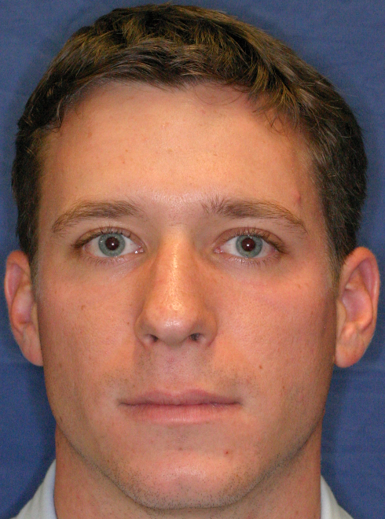
1. Introduction
Notes:
Face hallucination is a domain specific problem which generates HR face images from LR inputs. The main difference with generic image super resolution is that we need to specifically handle facial features, which are sensitive to humans.

Slide 4
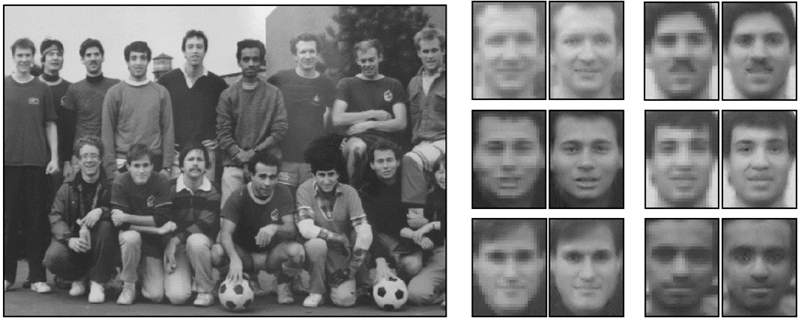
1. Introduction
Applications: Facial region recovery from existing photos.
Notes:
The applications of face hallucination consists of two aspects. The first one resides in the face image editing area where the LR face patches can be enhanced into HR for further editing purpose.

Slide 5
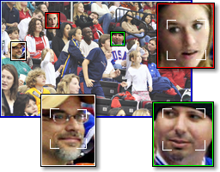
1. Introduction
Applications:
Low resolution
face recognition
under surveillance
scenario.
Notes:
The second one resides on video surveillance where it is adopted as a preprocessing step to upsample face images for face recognition.

Slide 6
1. Introduction
2. Related work
3. Proposed algorithm
4. Demo and results
Notes:
Here we give a literature survey of existing methods and analyze their advantages and limitations.

Slide 7
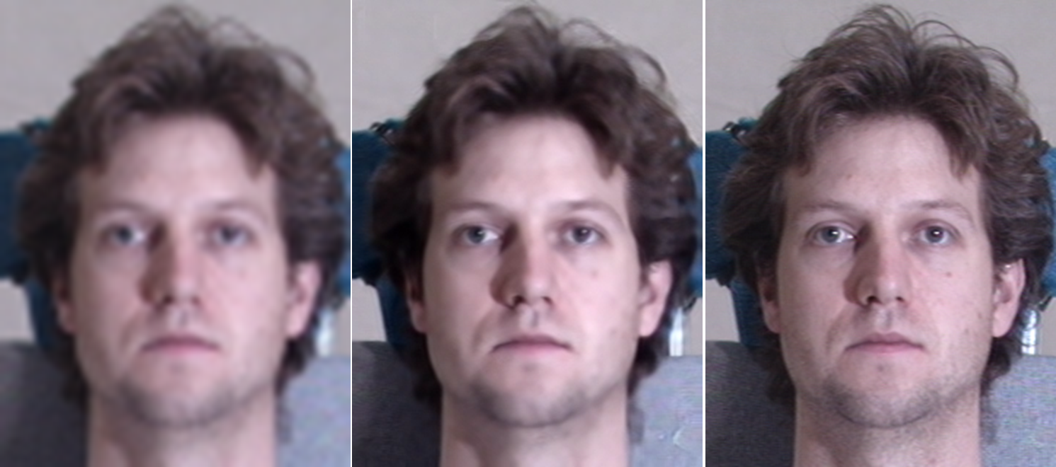
2. Related works: Learning based framework
Generic image SR
Face hallucination
Ground Truth
Notes:
Existing face hallucination methods mainly adopt data-driven framework. They construct a training dataset consisting of LR-HR image pairs. The correspondence between LR input and LR training images are established and then map HR training images into output results. Compared with generic image SR, face hallucination methods will transfer the HR facial components into LR inputs, which enrich the facial features and the results are easily recognized by human beings.

Slide 8
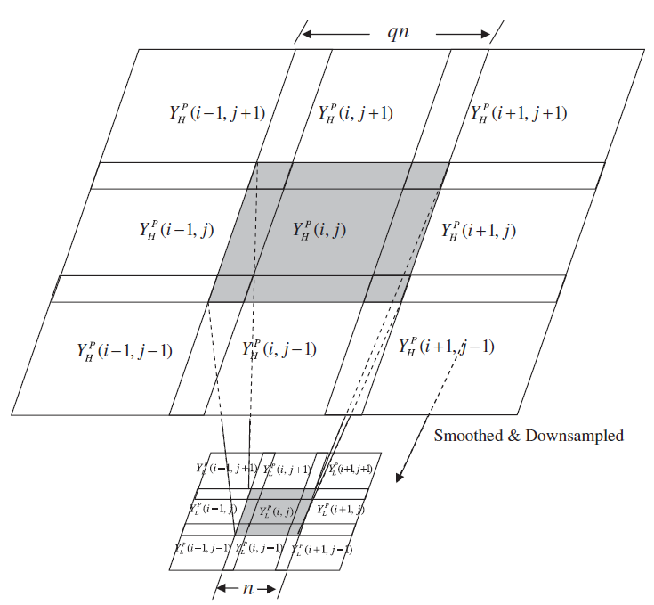
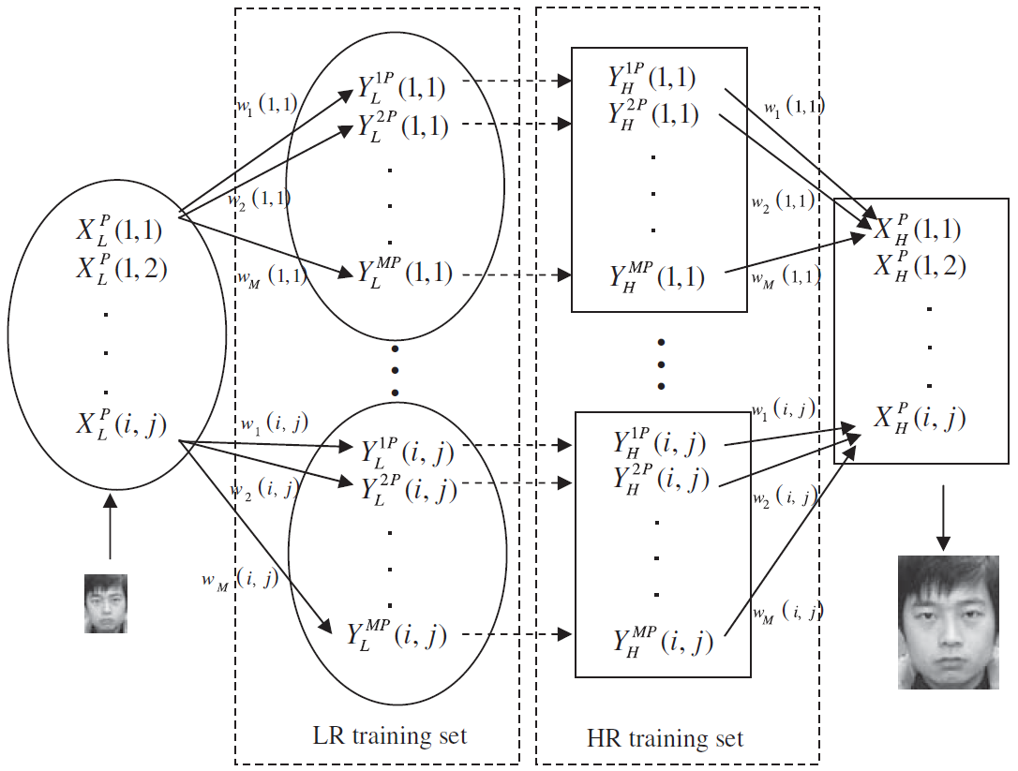
2. Related works: Learning based framework
Xiang Ma, Junping Zhang, Chun Qi. Hallucinating face by position-patch. PR 2010
Notes:
Typically, existing methods divide face images into local patches. They learn a linear mapping between the LR input and training images. Then they use this mapping function to map HR training images into output result.

Slide 9
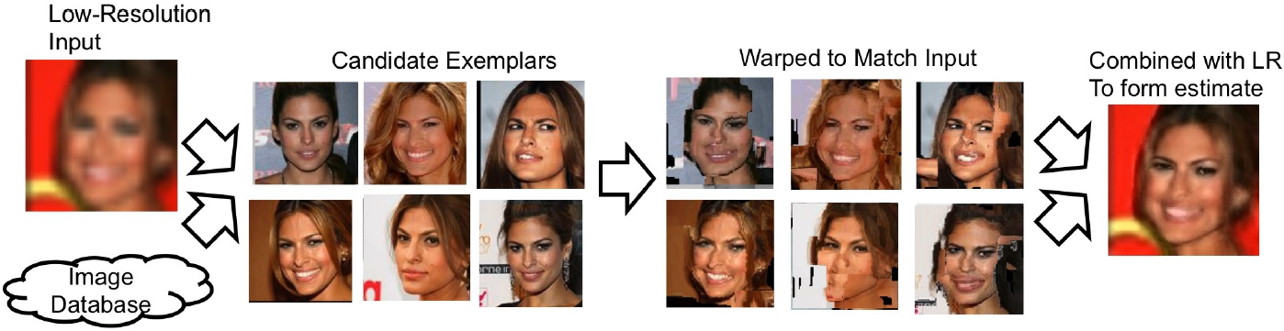
2. Related works: Learning based framework
Marshall Tappen, Ce Liu. A Bayesian Approach to Alignment-based Image Hallucination. ECCV 2012
Notes:
Furthermore, they align training images to match input LR input in pixel-wise and fuse the training images into output via Bayesian estimation.

Slide 10
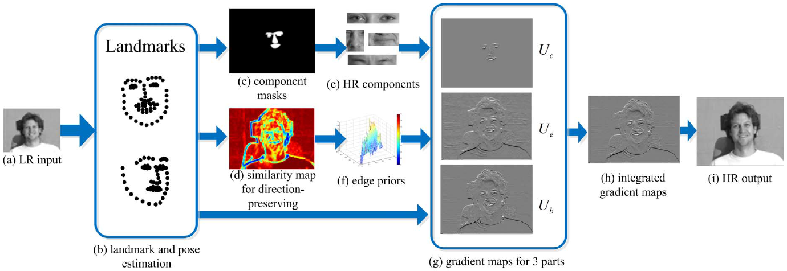
2. Related works: Learning based framework
Chih-Yuan Yang, Sifei Liu, Ming-Hsuan Yang. Structured face hallucination. CVPR 2013
Notes:
Moreover, they exploit the image gradients from the HR training images and transfer it into LR input. It enrich the facial structure and the edges are sharp. It reduces the blur effect caused by interpolation upsampling.

Slide 11
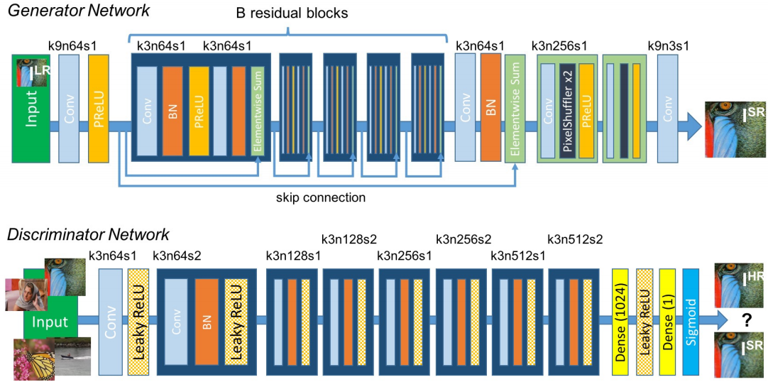
2. Related works: Learning based framework
Ledig et al. Photo-Realistic Single Image Super-Resolution using a generative adversarial network. CVPR2017
Notes:
Recently, deep learning based framework is popular. The GAN based framework is proposed to upsample input images which is visually similar with the ground truth image.

Slide 12
1. Introduction
2. Related work
3. Proposed algorithm
4. Demo and results
Notes:
Despite the demonstrated success, existing data-driven frameworks suffer from the accurate correspondence establishment between LR input and LR training images. As the resolution is typically low (e.g., 60*80) for a LR image, the discriminative ability of the empirical features are limited. The inaccurate correspondence will lead to erroneous HR image content transfer and brings blur and artifacts. Meanwhile, GAN based network does not focus on the pixel wise alignment between output and ground truth. They do not favor numerical numbers although the visual quality seems fine. In this work, we propose to generate deep features to establish accurate correspondence for solving this limiation.

Slide 13
3. Proposed method: Component Generation and Enhancement
Notes:
Our framework consists of two steps. First we generate deep facial component independently. Then we extract HR structures and enhance deep facial components. For the presentation purpose, in the following we use the whole image as the algorithm illustration.

Slide 14
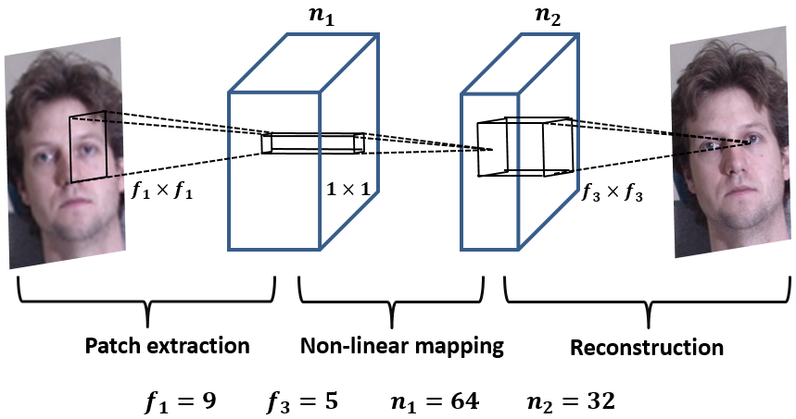
3. Proposed method: Component Generation
Chao Dong, Chen Change Loy, Kaiming He, Xiaoou Tang. Learning a deep convolutional
network for image super resolution. ECCV 2014.
Notes:
We generate facial components using several CNN networks. Each network follows the SRCNN structure and upsample input images. We segment facial components using masks and collect facial patches for each components. Then these facial patches are used for the network training. Through this process, we exploit the unique features for each facial component.

Slide 15
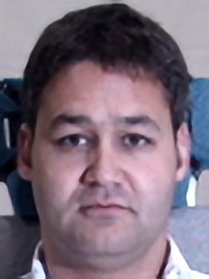
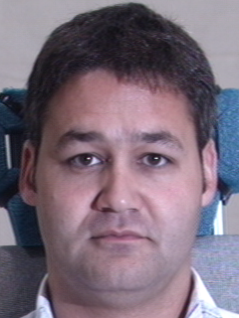
Notes:
We show an intermediate result upon this step. The left face image is obtained based on component generation and the right image is the ground truth. We observe that the flat region (e.g., cheek) is similar while the facial components (e.g., eyes, noses, mouths) are different. It is because CNN is not effective to enrich high frequency details during super resolution. However, the produced result can be regarded as an intermediate step to connect training and input images. Specifically, we generate the deep components of both training and input images. The components of training images will form a training pair with their HR counterpart. It is more descriptive to establish the correspondence compared with empirical features.

Slide 16
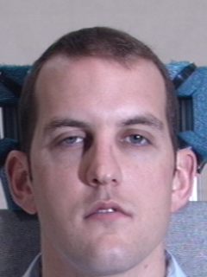
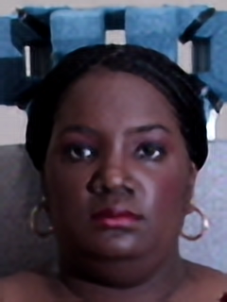
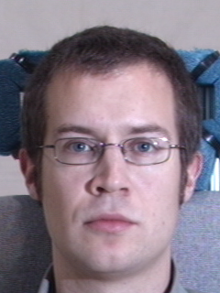
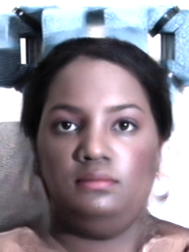


3. Proposed method: Component Synthesis
Patch search
Training pairs
$$𝓕$$
Notes:
After we construct the training pairs, we perform patch based K-NN search between the deep components of input and training images. We learn a linear regression based on the correspondences and use it to map HR counterparts into synthesized results.

Slide 17
Notes:
However, we observe that although facial components are enriched in the results shown on the right side. The base of the image is quite different compared with the CNN upsampled image shown on the left. It is because the synthesized image are from multiple training images and their lighting are different from each other. We then aim to extract the HR details from this synthesized image and add it back into the CNN upsampled image.

Slide 18

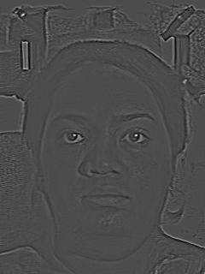





3. Proposed method: Component Enhancement
$$G$$
Substraction
Synthesized image
Extracted structure
Filtered result
$$G$$
Structured refined result
CNN upsampled image
Filtered result
Notes:
We aim to enhance the deep components using high frequency details using edge-preserving filtering. We are inspired by the flash and non-flash image denoising. We filter CNN upsampled image using the guidance as synthesized image. So the high frequency details will be transferred into filtered result. However, some details will be missing through the filtering process. Nevertheless, we will create a similar detail missing scenario where we filter the synthesized image itself. So the missing details will be captured through subtracting the filtered image using the original images and be added back to the deep components.

Slide 19
Notes:
As a result, our method will produce high quality facial component as well as low frequency base part shown on the right. It contains similar base component with the CNN upsampled images while maintaining high frequency facial components.

Slide 20
1. Introduction
2. Related work
3. Proposed algorithm
4. Demo and results
Notes:
In the following, we show the experiments.

Slide 21
4. Demo and results:
Benchmarks:
Multi-PIE frontal dataset
Multi-PIE pose dataset
PubFig dataset
Multi-PIE HR dataset
Real World Videos
Notes:
We conduct experiments on several benchmarks including multi-pie dataset and pubfig dataset. Meanwhile, we evaluate on the real world videos.

Slide 22
4. Demo and results:
Evaluation methods:
FHTP: Face Hallucination: Theory and Practice. Liu et al. IJCV 2007.
2. SCSR: Image Super-Resolution via Sparse Representation. Yang et al. TIP 2010.
3. SFH: Structured Face Hallucination. Yang et al. CVPR 2013.
4. SRCNN: Image Super-Resolution using Deep Convolutional Networks. Dong et al. PAMI 2015.
5. SRResnet: Photorealistic Single Image Super-Resolution using a Generative Adversarial
Network. Ledig et al. CVPR 2017.
Evaluation metrics: PSNR / SSIM
Upscaling Factor: 4, 10
Notes:
We compare with state-of-the-art image super resolution and face hallucination methods (FHTP, SCSR, SFH, SRCNN and SRResnet). The evaluation metric is PSNR and SSIM. The upscaling factor during the experiments are set as 4 and 10.

Slide 23
4. Demo and results:
Multi-PIE Frontal Dataset: 4x
FHTP
Ours
Notes:
We show the visual comparison with FHTP on the multi-pie frontal dataset. The left region is zoomed in via close ups. It indicates that our method perform favorably against the FHTP. The reason is that we use deep component to accurately establish the correspondence between HR and LR and thus enable effective detail transfer.

Slide 24
4. Demo and results:
Multi-PIE Pose Dataset: 4x
SFH
Ours
Notes:
Our method performs well on the pose variation datasets. The close up indicates the mouth region where incorrect gradient transfer appears in the SFH results. In comparison, our method does not suffer from this process.

Slide 25
4. Demo and results:
PubFig Dataset: 4x
Resnet
Ours
Notes:
In the pubfig dataset, our method performs favorably against SRResnet. Because of accurate HR detail transfer, we achieve higher quality facial components.

Slide 26
4. Demo and results:
Multi-PIE HR Dataset: 10x
SRCNN
Ours
Notes:
We also conduct experiments on the upscaling factor of 10. We achieve superior performance compared with SRCNN. The nose region is zoomed in via the close up.

Slide 27
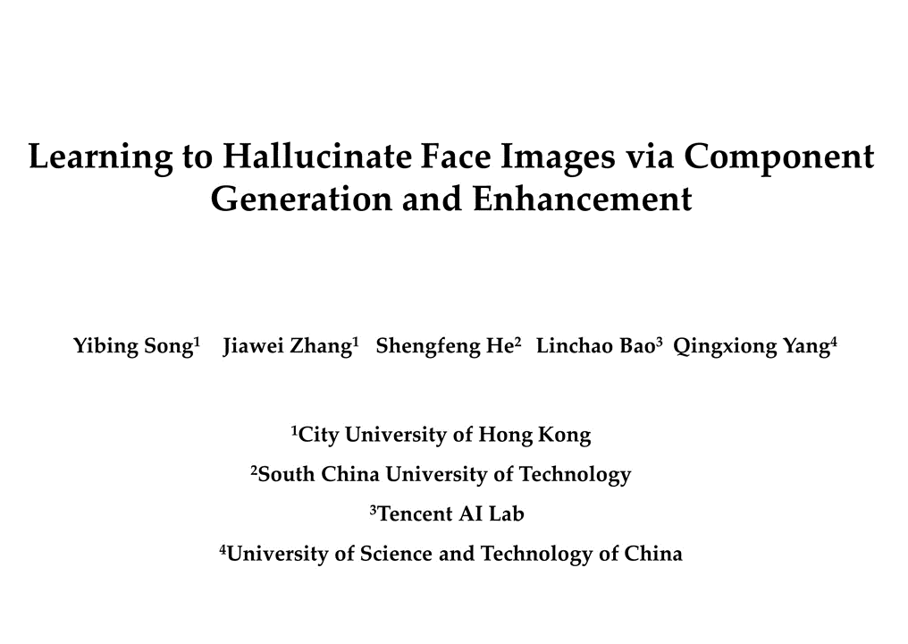
Notes:
Here, we show the real world video demo. (Read the sentences is fine.)

Slide 28
Take-home messages:
1. Face hallucination transfers the HR training details into LR input.
2. We construct LR-HR correspondences using deep components.
3. We extract HR details and add them back using edge-preserving filtering.
4. State-of-the-art performance on both benchmarks and real world data.
Notes:
Read the slides.

Slide 29
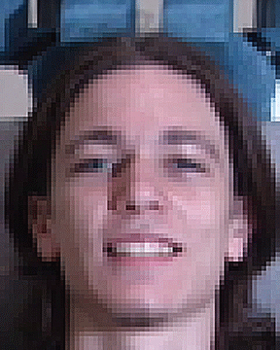
Project website:
http://www.cs.cityu.edu.hk/~yibisong/ijcai17_sr/index.html
Thanks ☺
Questions?
Notes:
We have set up the websites. Any questions are welcome. (Please stay on this slide because of gif refreshing. It will leave impression on the audience.)

